Slide 1


Slide 2

Warehouse Management System

Slide 3
Group Members Introduction
JEHAN ZEB (BC200400749)

Slide 4

INTRODUCTION OF PROJECT
The Warehouse Management System for ABC Company encompasses the development of a comprehensive web-based application aimed at optimizing and automating the company's warehouse operations in Lahore, Karachi, Rawalpindi, Faisalabad, and Quetta. The system will include user authentication and authorization functionalities, allowing the admin to create, update, and delete user accounts with specific rights. Admins will be able to manage the chart of accounts, including parent accounts, control accounts, and ledger accounts. Users, based on assigned rights, can enter, update, and delete records, generate detailed reports on stock movements, create vouchers for incoming and outgoing products, and review ledger entries. The system will facilitate decision-making by providing insights through various reports, including inventory reports, stock aging, stock value reports, and stock movement reports. The project will be developed using HTML, CSS, JavaScript, PHP, and MySQL, delivering a fully functional system with user documentation, source code, and training materials.

Slide 5
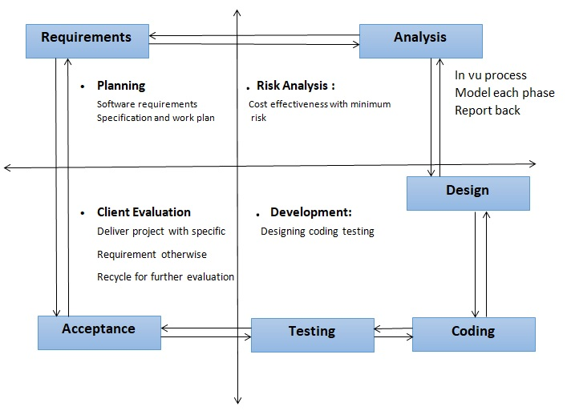
Process Model

Slide 6
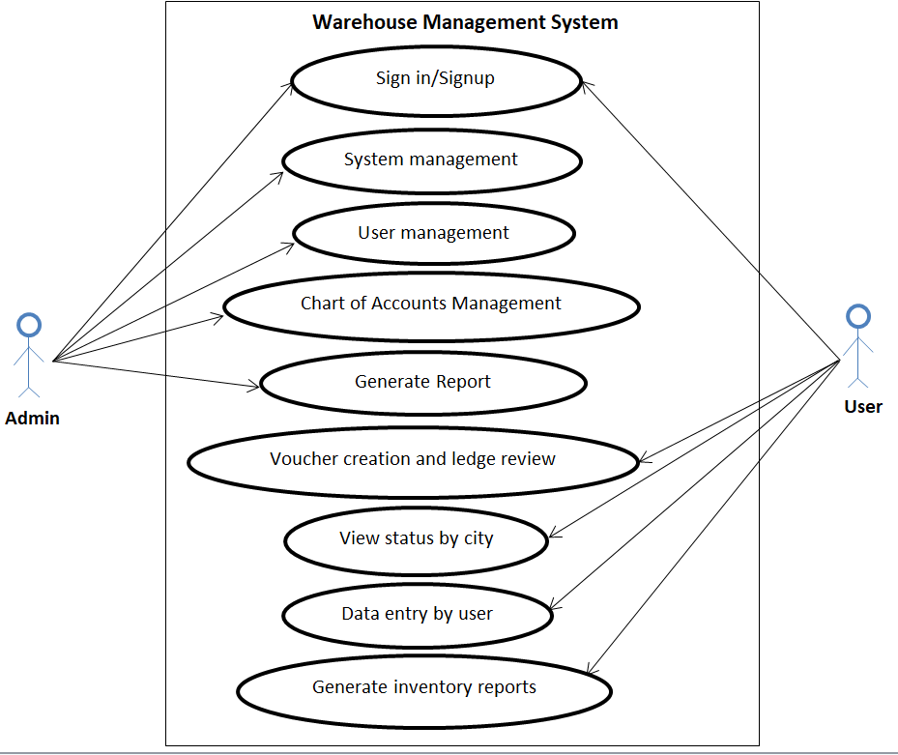
Use Case Diagram

Slide 7
Business Rules Catalog
Admin will log in to the system using their login ID and password.
Admin can create users and give rights to other users.
Admin can use the entire system to enter, update, and delete any record.
Admin can manage a chart of accounts (parent accounts, control accounts, and ledger accounts).
Admin can generate a detailed report to view item-wise, day-wise, week-wise, or month-wise details of items coming in and out of the stock, and brand-wise details of items coming in and out.
Only Registered users will be able to login to the system.
User can also enter, update, and delete if the admin grants them complete rights.
User can enter data into the system, such as creating vouchers and reviewing ledgers.
User can view a report of all items in the warehouse by city.
User can generate different reports such as inventory reports, stock aging, stock value reports, and stock movement reports.

Slide 8
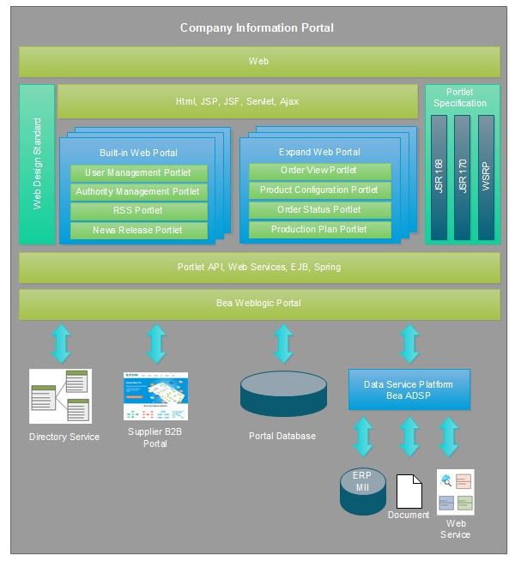
Architectural Design

Slide 9
Team Structure
No Member

Slide 10
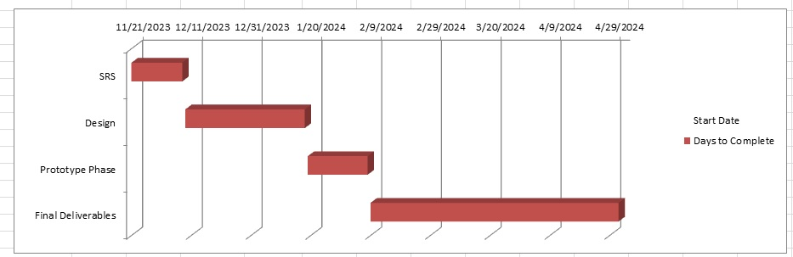
Project Schedule

Slide 11
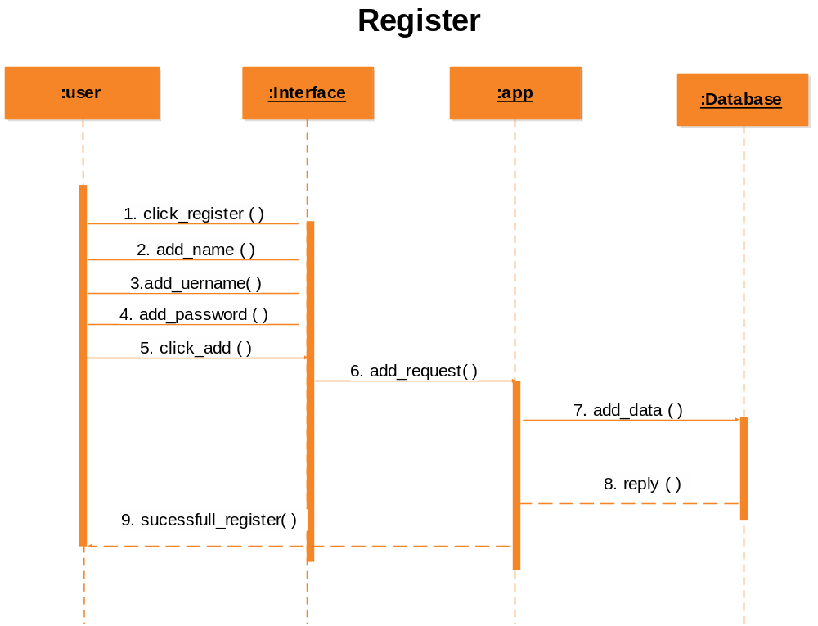
Sequence Diagrams (continue)

Slide 12
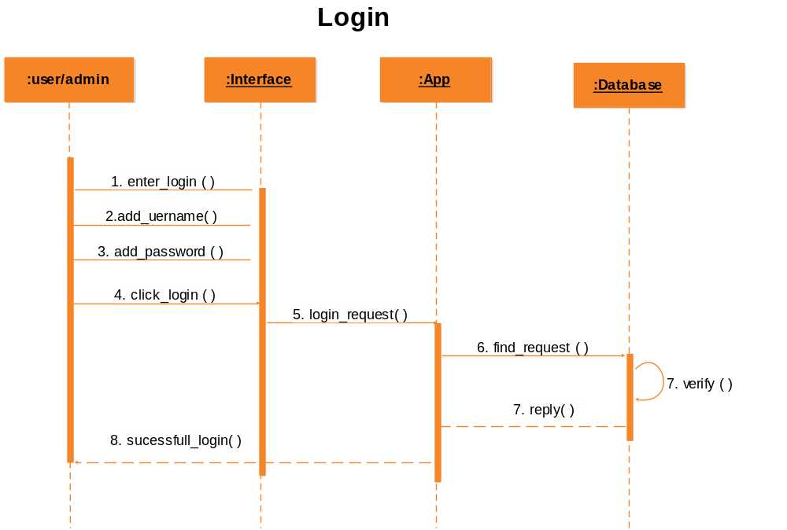
Sequence Diagrams (continue)

Slide 13
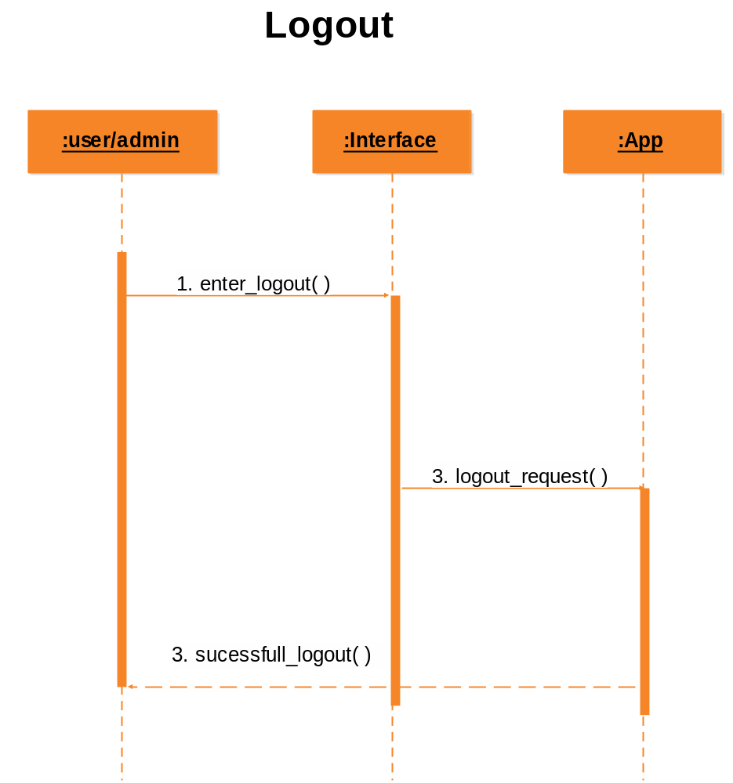
Sequence Diagrams (continue)

Slide 14

Sequence Diagrams (continue)

Slide 15
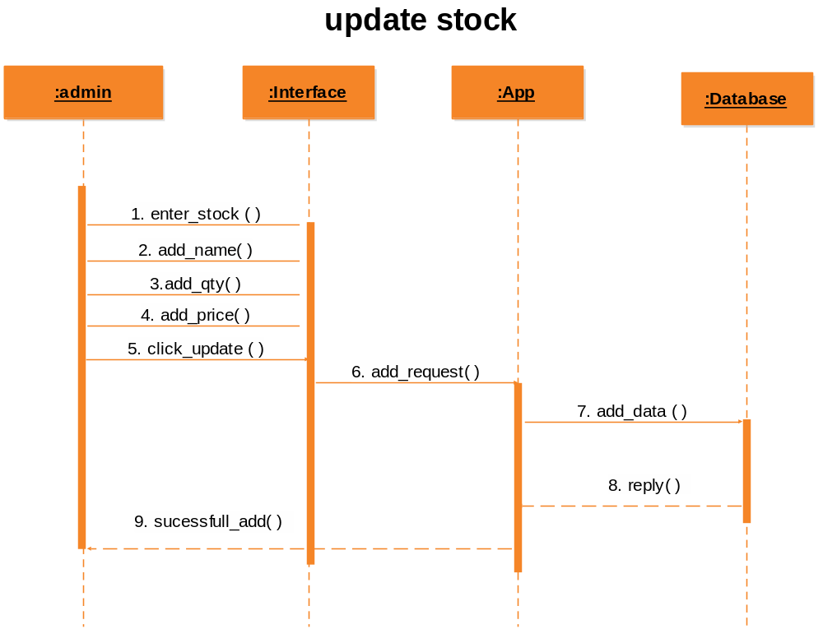
Sequence Diagrams (continue)

Slide 16
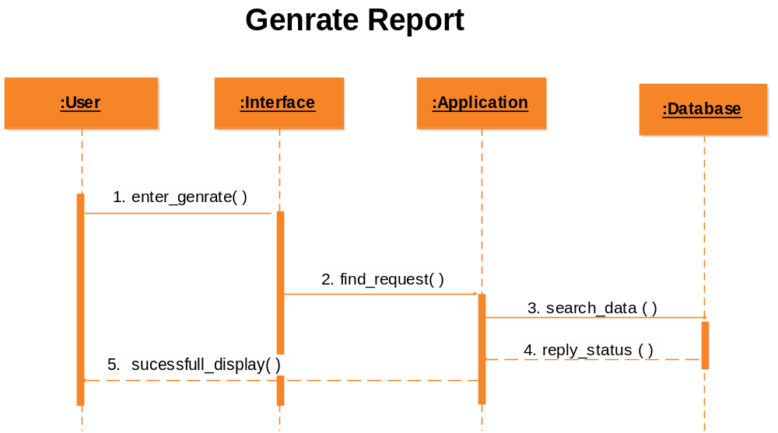
Sequence Diagrams (continue)

Slide 17
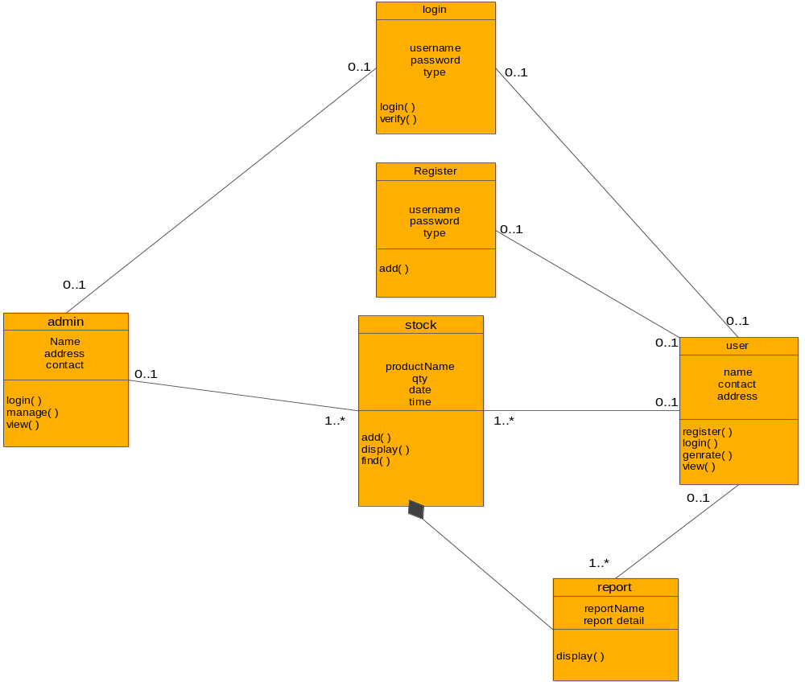
Logical Model/Class Diagram

Slide 18
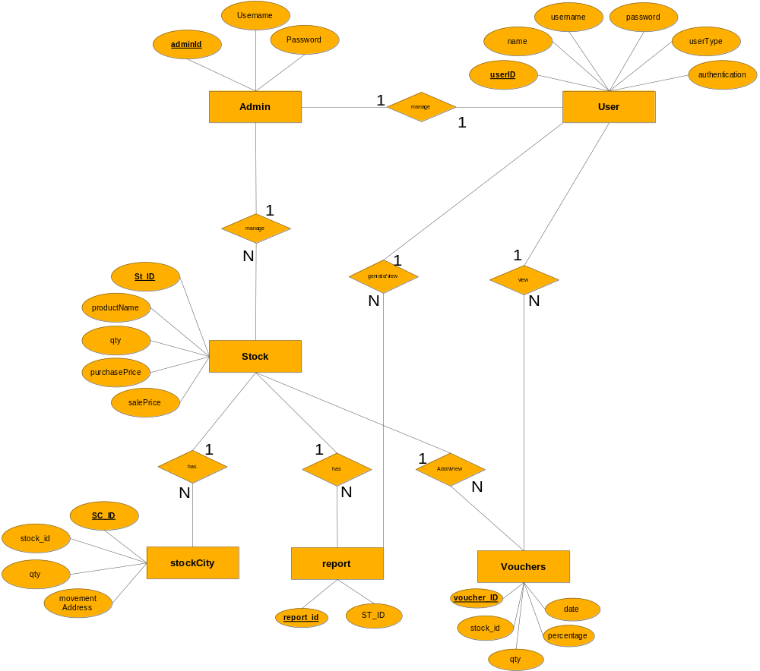
Entity-Relationship Diagram

Slide 19
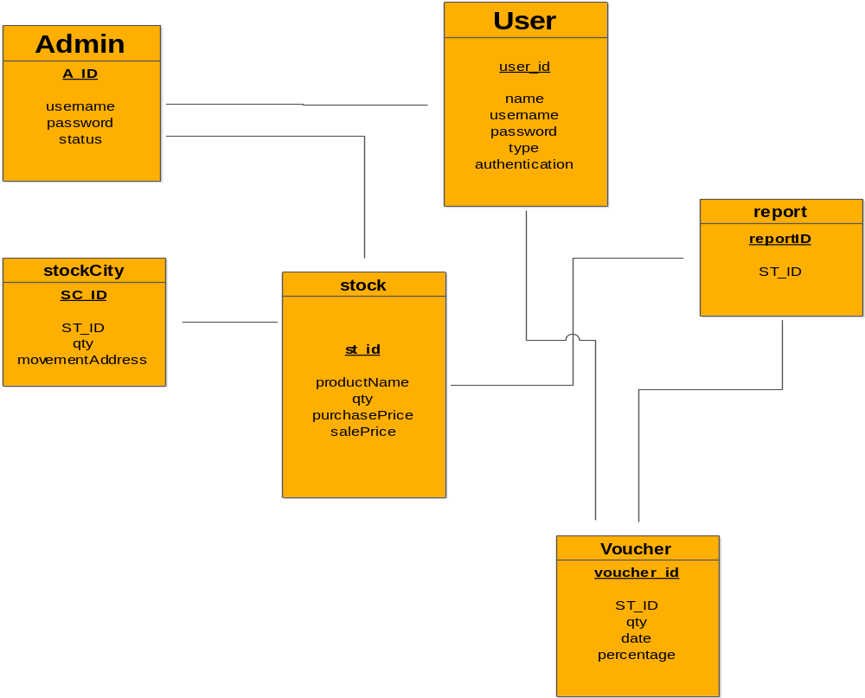
Database Diagram

Slide 20
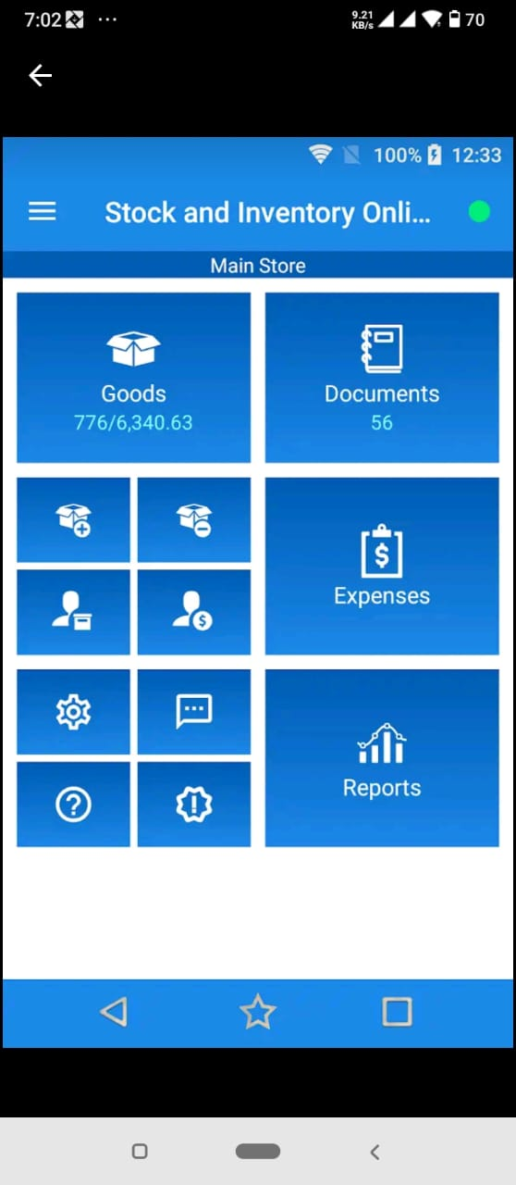
User Interfaces

Slide 21
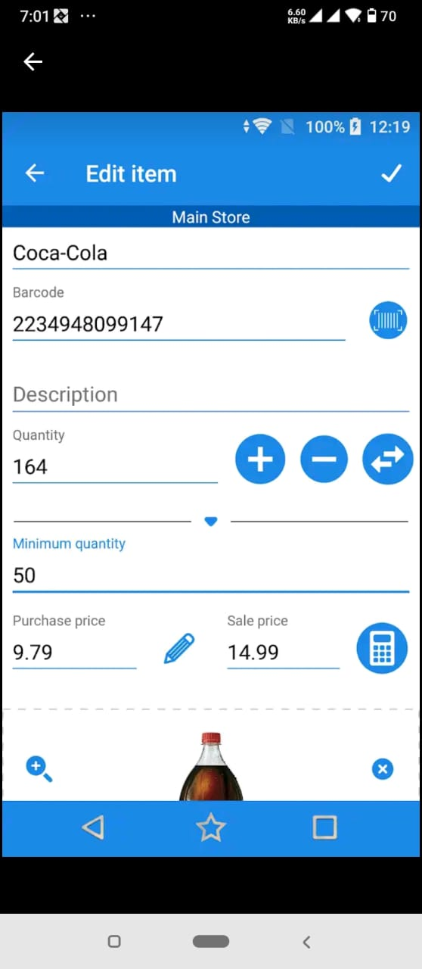
User Interfaces

Slide 22
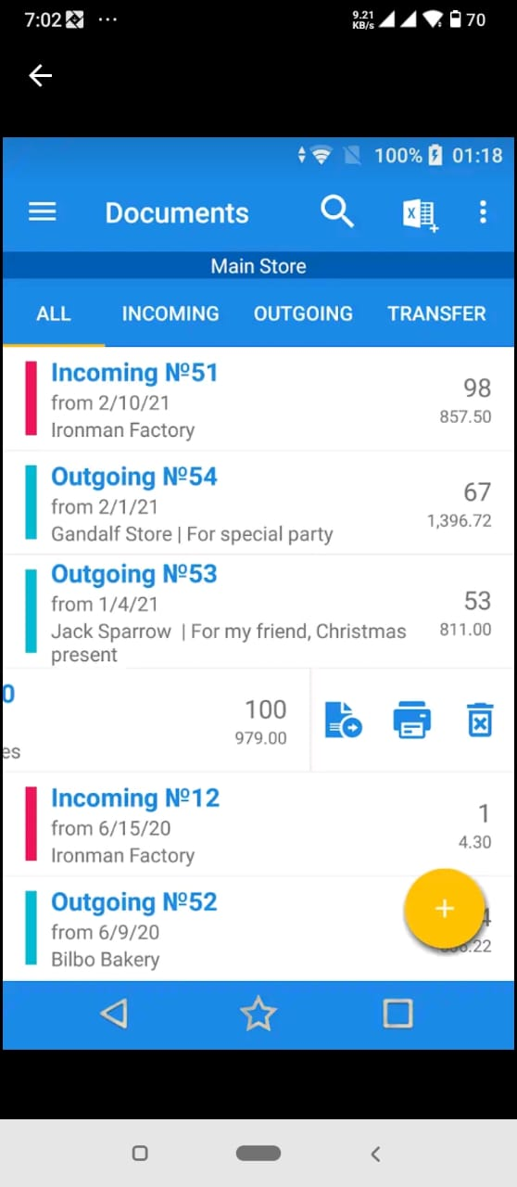
User Interfaces

Slide 23
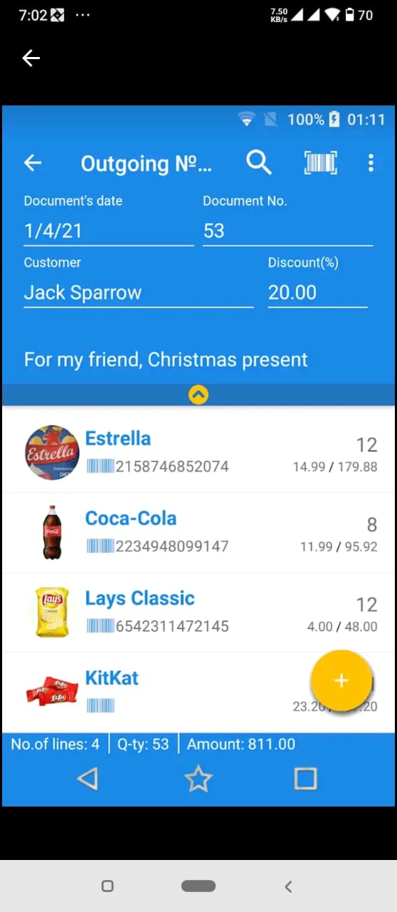
User Interfaces

Slide 24
Tools
Php
MySql

